Slide 1
Project Plan Presentation PIVOANE PIéton, Vitesse, dOs d’ANE
OUR TEAM
Sara Bassanetti
Emeline Delhay
Achraf Laazizi
Luiz Renato Rodrigues Carneiro
Léa Scheer
Yuchen Xia
Gwendolyne Le Corre
Thierry Monteil
TUTORS
Notes:
Hello,
My name is Luiz Renato …
Our tutors are Gwendolyne Le Corre and Thierry Monteil
This is the presentation of the review 0 with our project plan of the autonomous vehicle project. The name of our project is PIVOANE due to the translation of the words pedestrian, speed, and speed bump in french.

Slide 2







Table of content
Context
Product Description
Operational requirements
Validation Plan
Backlog​
​
Sprint 1​
​
Risk analysis and solutions​
​

Slide 3







Context
53,540 accidents in France, 2021
90% of accidents are caused by human factor
67,057 injured people
Speed is the cause of 25% of fatal accidents
2,944 deaths
Including 963 deaths in urban area
Notes:
Why is an autonomous vehicle important? Is it safer than a human driving a car?
To answer that I will present some statistics. In 2021 53 thousand accidents occurred in France, there were 67 thousand injured people and 3 thousand deaths. Furthermore, ninety percent of these accidents were caused by human factors mainly caused by alcohol, speed limit, tiredness and drowsiness.
Thus, the development of the autonomous vehicle has a potential to mitigate these accidents and traffic fines for users.

Slide 4
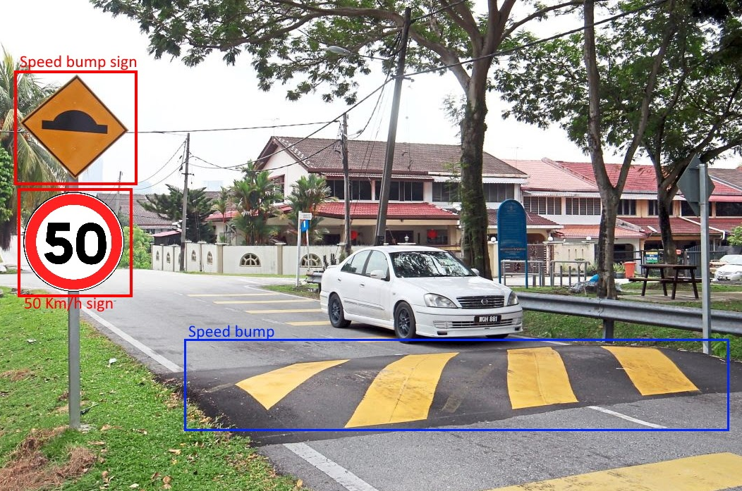

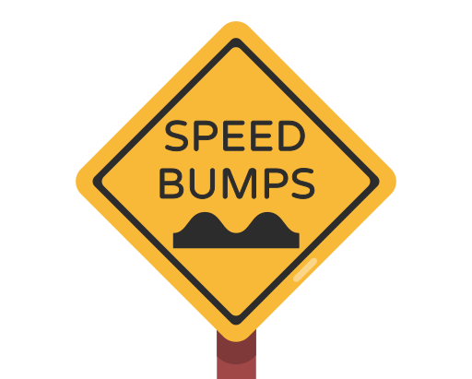
Product description
Adapt the car's behavior according to the environment detected in different complex situations
Adjust the speed of the car when a speed sign is detected
Stop the car when there are pedestrians on the road
Slow down when approaching a crosswalk or speed bump

Slide 5
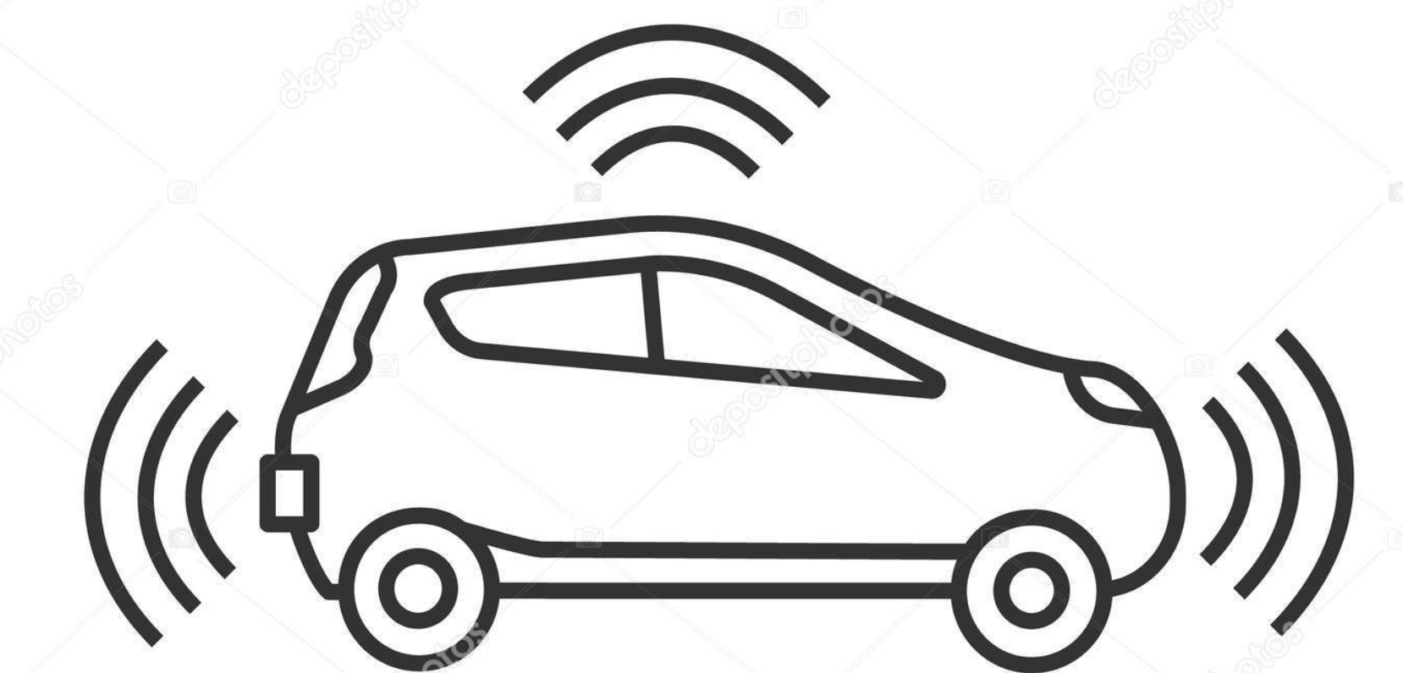
January release
The car shall drive autonomously in a straight line with GPS localization
Speed traffic sign detection
The car will pass near speed traffic signs on the road and shall change its speed accordingly
Crosswalk and pedestrian detection
The car shall slow down before a crosswalk
The car shall stop before the crosswalk if there is a pedestrian waiting
The car shall stop instantly if a pedestrian appears quickly
Speed bump detection
The car shall detect a speed bump, slow down and recover its previous speed after passing it

Slide 6



Operational requirements
General behavior
• The car shall have a max deviation margin when on a straight line of 10°​
half speed
• The car shall run on a straight line for 20 meters​
unmoving
full speed
The car shall:
• Go from full speed to unmoving in less than 5 meters​
• Go from full speed to half speed before reaching the speed-limit road sign (2 meters)
​
• Using the GPS, the car shall follow the predefined path with an error of up to 2 meters
Notes:
The operational requirements are crucial to inform the condition or capability needed by the user and that the system should respect.
The first requirement is related to the steering of the car, the car shall have a max deviation margin when on a straight line of 10° and shall run on a straight line for 20 meters. Using the GPS, the car shall follow the predefined path with an error of up to 2 meters.
The second part is related to the speed requirement, the car shall go from full speed to unmoving in less than 5 meters and go from full speed to half speed before reaching the speed-limit road sign (2 meters).

Slide 7


Operational requirements
How objects are detected
The car shall:
• Detect and recognize at least 95% of the road signs and pedestrians
• Recognize a road sign in less than 1 second
Detect pedestrian/obstacles in less than 1 second
•Detect the pedestrian/obstacles at less than 5 meters
​
Notes:
The third part is the object detection requirement, the car shall detect and recognize at least 95% of the road signs and pedestrians, recognize a road sign, pedestrian and obstacles in less than 1 second, detect pedestrian/obstacles in less than 1 second and detect the pedestrian/obstacles at less than 5 meters.

Slide 8



Operational requirements
How the car will behave after detection
1 meter
Slow down
Accelerate
• The car shall stop at least 1 meter away from pedestrian​
• The car shall detect the speed bump and reduce the speed in less than 1 meter before passing it, after passing the speed bump recover the previous speed
• After stopping in front of a pedestrian, the car must not move until the pedestrian leaves
The car must not run over a pedestrian or obstacle​​
Notes:
And the last requirement is the behaviour of the car after the detection. The car shall stop at least 1 meter away from pedestrians, After stopping in front of a pedestrian, the car must not move until the pedestrian leaves. The car must not run over a pedestrian or obstacle​​. Detect speed dump and reduce the speed in less than 1 meter before passing it, after passing the speed dump recover the previous speed. All these test will be done outside

Slide 9

Validation Plan
SPRINT 3
SPRINT 1
SPRINT 5
Add a speed bump or a pedestrian on the street. Car will have to stop before reaching the pedestrian, or slow down to not damage the car when going over the speed bump.
Car placed on a straight road must drive through it by not deviating from its trajectory. It should reach a wanted speed.
The car will use the GPS to locate itself and follow a planned path. Other types of obstacles will also be added to the road.
SPRINT 2
SPRINT 4
Add a single road sign on the road. Verify the car slows down before reaching it. Car must slow down directly after recognizing a road sign.
We will add multiple road signs and moving pedestrians. The car will have to deal with multiple events and prioritize depending on the situation.

Slide 10




Backlog
Speed control
Control the car’s speed to reach a specified one
Move on a straight line
Run on a straight line
AI training
Create and train the AI model which detect road signs and pedestrian
Environment creation
Create an environment to test the car behavior

Slide 11




Backlog
Road sign detection
Detect and recognize road signs
Pedestrian detection
Detect a pedestrian
Speed bump detection
Detect a speed bump
Avoid obstacles
Decelerate after the detection of an obstacle

Slide 12




Backlog
Measurement of the distance
Measure the distance between car and pedestrian
Movement priority
Prioritize car movement in the case of multiple detections in a complex environment
Locate with GPS
Use GPS to locate the position of the car
Turning
The car is able to turn

Slide 13





Sprint 1
User Story 1:
The car must keep a straight trajectory
Wheels
synchronization
Restrain car drift
Test:
Ensure the car can follow a straight trajectory on at least 20 meters
Discover ROS 2
Test:
Measure the drift angle of the car
Notes:
We divided our first print in 3 different user stories.
First, as a user, I want my car to keep a straight trajectory on a road.
To do so, we will have to discover ROS 2, a set of libraries and tools the car is using. The entire team is going to work on it because we want everyone to be able to understand the basic working of the car.
The first problem is that the car wheels aren’t synchronized, meaning the left and the right doesn’t turn together. We will work on a way to solve this, and ensure the wheels are turning at the same speed, at the same time control engineering technics.
Finally, because of the wheels, the car will probably have a drifting problem, meaning it won’t exactly go straight ahead. To limit this, and ensure the car stay on the road and doesn’t hit a sidewalk, we will probably have to test it multiple time and correct it gradually.
To ensure the functioning of this user story, at the end of the sprint, we will place the car on a straight street near the STPI. The car will have to drive for at least 20 meters, and we will verify the drift is not too much.

Slide 14

Sprint 1
User Story 2:
The car can accelerate and decelerate until reaching full stop
Control speed between 0 and 5 km/h
Calculate speed
Calculate response time
Test:
Test the acceleration and deceleration on a straight line
Notes:
For the second user story, as a user, I want my car to be able to slow down or accelerate. Considering the car can reach up to 5 km/h, we have to determine which PWM value in input give which speed value as an output. We will also have to calculate the response time and inertia to determine how long it will take to slow down.
To test our car speed control, we will program the car to accelerate at the start of the road, and slow down, then stop at the end.

Slide 15

Sprint 1
User Story 3:
The car will read and print the data from some sensors
Read sensors datasheets
Print data
Communicate with the sensors
Test:
Verify the printed data
Check the sensor precision
Notes:
Finally, our last story is “The car will read and print data from some sensors”. In our case, our team decided we will probably work with the camera for the signs recognition, with the Lidar for the pedestrians and obstacles detection and the GPS to locate our car.
To start, we have to find the sensors datasheet and read them. It will help us know the data type and structure. We will also look for existing modules and previous projects to see if some code parts could be reused.
Then we will start writing the code to communicate with the sensors and receive data. We will then print the data on the computer screen.
To verify the data received, we will used what we learned in the datasheet and the ensure the printed data correspond to what we want and are understandable. For the Lidar, we will try to place different kind of obstacles to see how it reacts to them. And finally, for the GPS, we will look at the location precision to verify its usefulness.

Slide 16
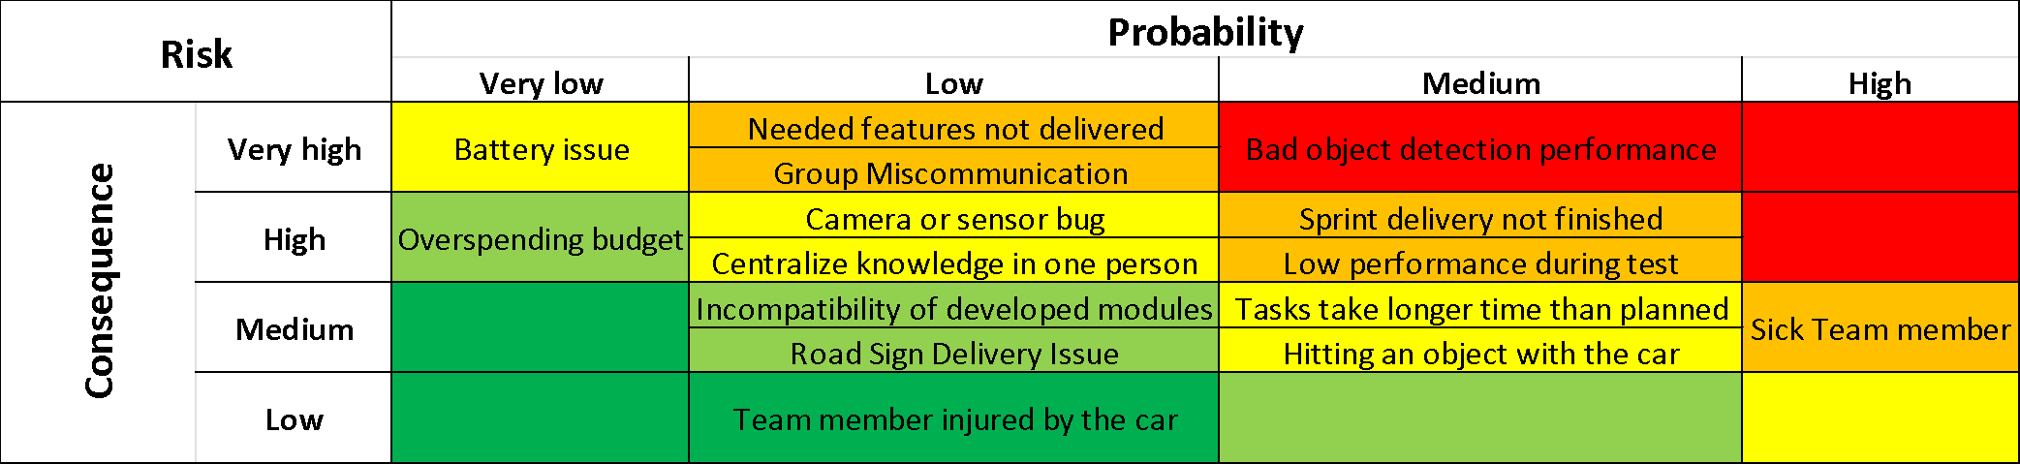
Risk analysis
Bigger Consequence
More probable

Slide 17

Risk preventions and solutions
Preventions and solutions to human risks
 | Group Miscommunication | Team member not performing well | Sick team member | Team member injured by the car
Preventive measures | - Ensure everyone knows their role and understands our goals - Regular meetings - Use Jira | - Select tasks that match the person's qualification/interest - If complex task create a bigger team to accomplish them | - Share the task with more than one person - Write documentation | Always be cautious. Do not walk in front of the car if we are not sure it will stop
Solutions | Call a meeting to talk about the problem | - Switch the task with another member - Put another member to work with this person or team | Fast-moving group members share part of the task of the group member who is sick (remote work if necessary) | Use first aid and do remote work if necessary

Slide 18

Risk preventions and solutions
Preventions and solutions to organizational risks
 | Needed features not delivered | Road sign delivery issues | Sprint delivery not finished | Centralize knowledge in one person | Tasks take longer than planned
Preventive measures | -Do incremental improvements for all functionalities in each sprint - Check the advancement of the features and test them | Order the Road Signs early on and look at different websites to compare delivery delay | - Scrum master supervision to alert before this problem occurs - Divide the sprints into suitable sizes | Share the task with more than one person and write documentation | - Plan each sprint and evaluate time required for each task - Overestimate the time bit for each sprint - Check the progress of the project regularly
Solutions | Raise the priority of this needed feature and synchronize the progress of other | Use different objects as road signs or draw them in a paper | Add the remaining tasks into the next sprint and raise their priority | Group member who has completed the task reports to the others on the work done | If late, change the backlog or reduce workload for the next sprint

Slide 19

Risk preventions and solutions
Preventions and solutions to technical risks
 | Incompatibility of developed modules | Bad object detection performance | Camera or sensor bugs | Low performance during test | Hitting an object with the car | Battery issue
Preventive measures | - Use GitHub to manage the files in different branches and merge them - Use ROS to make the compatibility simpler | - Use a developed object detection module - Work with a big dataset | - Verify sensor connections - Do not use the car when it is raining - Manipulate the car carefully | Test the project regularly (at least once a week) | Specific tests with small or soft objects | Verify the battery level
Solutions | Work quickly on the incompatibility errors | - Change the AI model - Use more data | - See with José Martin if he has spare parts | Rework our expectations | Try to understand the reason behind the crash | Charge or change the battery

Slide 20

Thank you for your attention!
Do you have any questions?

Slide 21
Sources
www.flaticon.com
www.onisr.securite-routiere.gouv.fr/etat-de-l-insecurite-routiere/bilans-annuels-de-la-securite-routiere/bilan-2021-de-la-securite-routiere
https://www.justifit.fr/b/guides/droit-routier/causes-accidents-de-la-route/

